Slide 1

Reading Assessment at William Ransom School
Through the use of the materials from Herts for Learning, there is a clear pathway of progression for reading. We assess reading using age appropriate books in 1:1 reading sessions with teachers and teaching assistants and guided reading sessions. Children who are fluent readers also undertake termly reading assessments.
In the following slides, you can see end of year expectations for reading.

Slide 2
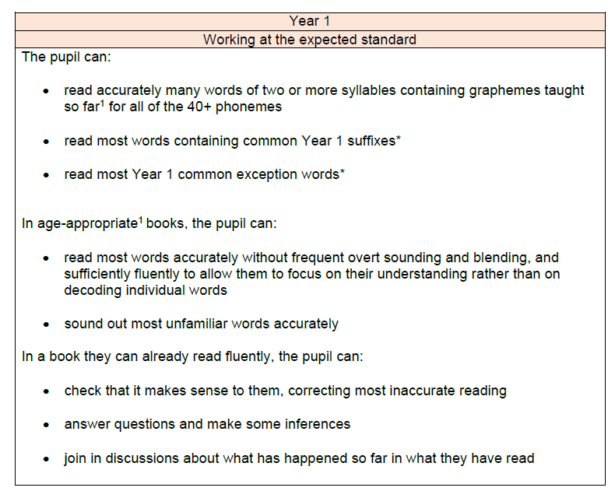

Slide 3
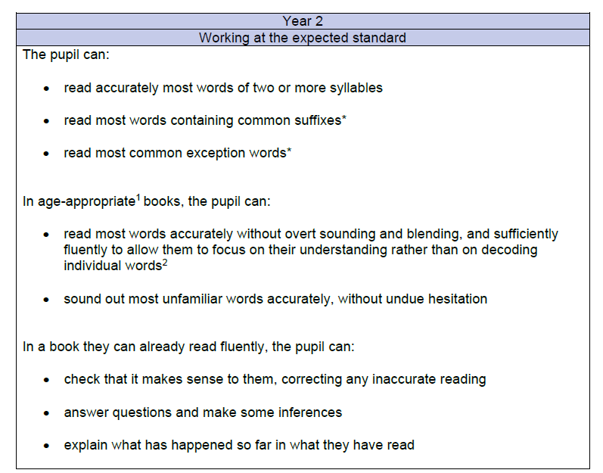

Slide 4
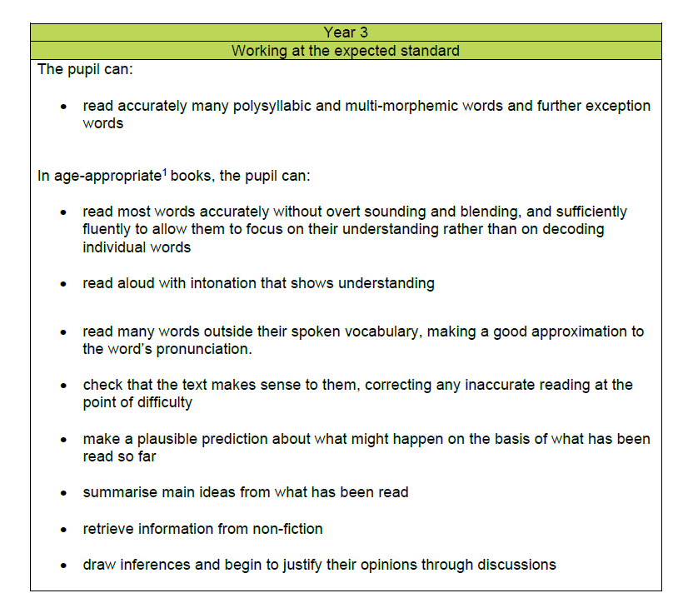

Slide 5
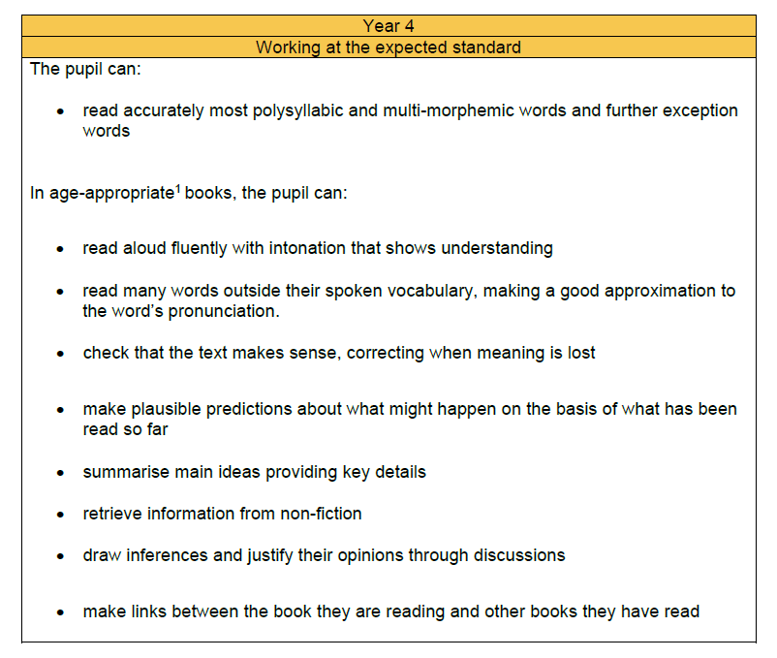

Slide 6
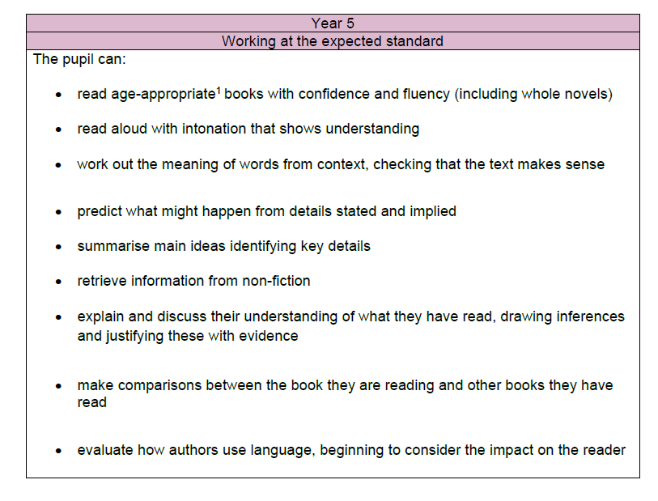

Slide 7


