Slide 1

KS1& 2
Information for Parents
How you can support your child in English

Slide 2
English:
Reading
Phonics
Writing
Speaking and Listening

Slide 3
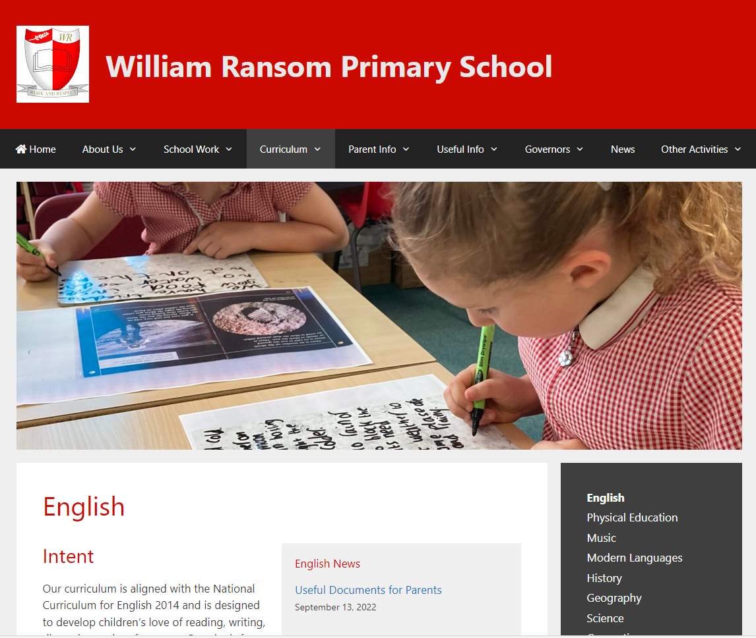
Where to find useful information: our website
Intent, Implementation & Impact Document
Intent – our aims for our English teaching
Implementation – how we teach English
Impact – measure progress and effectiveness of everything we do in English

Slide 4
Bug Club Phonics Overview
Reception
Phases 2, 3 and 4
Year 1
Phase 3 revision
Phase 5 to be completed by May half term
Phase 6 may be taught after the Screening Check depending on the cohort
Year 2
Phase 5 revision/alternatives
Phase 6

Slide 5
Phonics in Year 1
13 – wh ph
14 – ay a-e eigh/ey/ei
15 – ea e-e ie/ey/y
16 – ie i-e y
17 – ow o-e o/oe
18 – ew ue u-e u/oul
19 – aw au al
20 – ir er ear
21 – ou oy
22 – ere/eer are/ear
23 – c k ck ch

Slide 6
Phonics in Year 2
Phase 5 alternatives
24 – c(e) c(i) c(y) sc st se
25 – g(e) g(i) g(y) dge
26 – le mb kn gn wr
27 – tch ea s wa o
Suffixes
-ing
-ed
-s
-es
Prefixes
re-
un-

Slide 7
Phonics Terminology
Phoneme - the smallest unit of sound as it is spoken
Grapheme - a written symbol that represents a sound (phoneme) that's either one letter or a sequence of letters
Digraph - two letters that work together to make the same sound (ch, sh, ph)
Vowel digraph - a digraph in which at least one of the letters is a vowel: boat or day
Consonant digraph - two consonants which can go together: shop or thin.

Slide 8
Phonics Terminology
Split digraph (sometimes called 'magic e') - two letters that work together to make the same sound, separated by another letter in the same word. This enables children to understand the difference in vowel sounds between, for example, grip/gripe, cop/cope, tap/tape
Trigraph - three letters that work together to make the same sound (igh, ore, ear)
Pure sound - it's the skill of pronouncing each letter sound clearly and distinctly without adding additional sounds to the end e.g. 'f' not 'fuh.‘

Slide 9
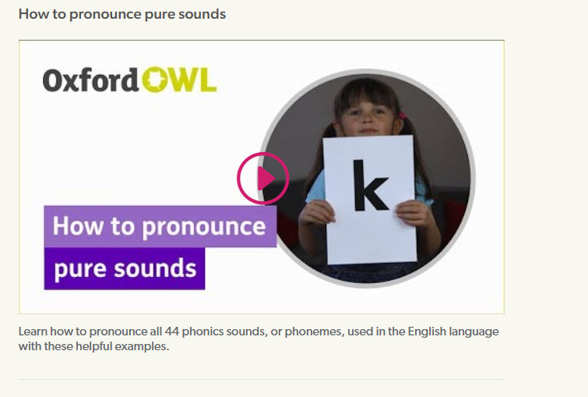
Phonics videos – help your child learn to read - Oxford Owl
Google Oxford Owl Phonemes – how to pronounce pure sounds​

Slide 10
Phonics Terminology
Blend - this is when you say the individual sounds that make up a word and then merge or blend them together to say the word as used when reading
Segment - it's the opposite of blending as it means splitting a word up into individual sounds when spelling and writing.

Slide 11
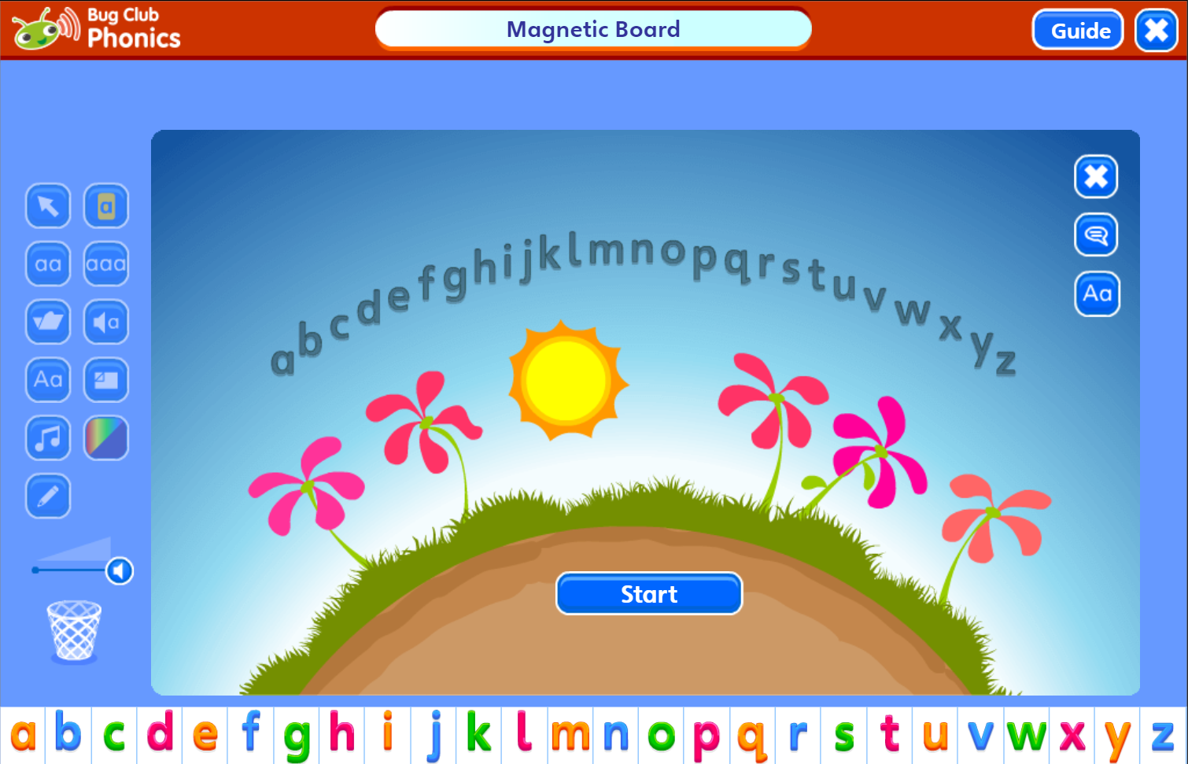
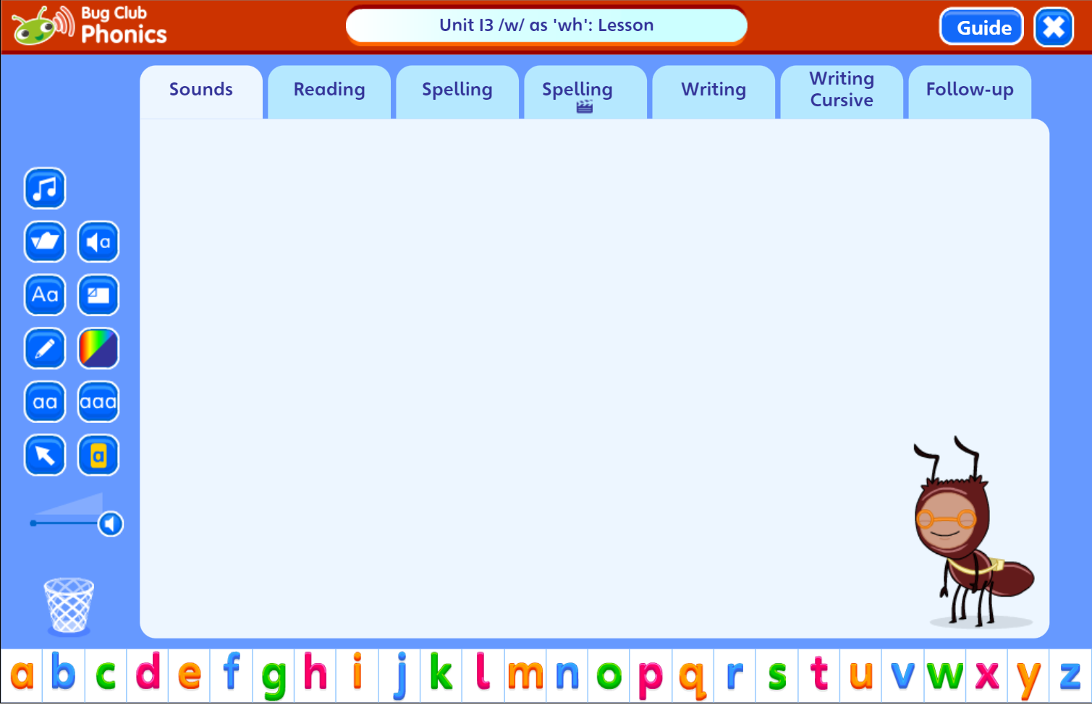
What does a Bug Club lesson look like?

Slide 12
What can you do at home?
Help your child to complete any Phonics homework they bring home
Encourage your child to use their phonics when they are reading at home
Useful websites: phonicsplay.co.uk
topmarks.co.uk
phonicsbloom.com
Listen to your child read every night – sign and date the Reading Records. Make sure their reading books are in school every day.
Bug Club reading books set weekly for Years 1 and 2

Slide 13
Useful documents for parents:
SPAG Glossary and definitions
Word grids to support spelling
Statutory spellings
End of year writing expectations
Reading Tips for parents
End of year reading expectations
Recommended reading lists by year group

Slide 14
Keystage 2 -What can you do at home?
READING
Help your child develop fluency in reading
Regular reading with your child at home (the more the better and please record this in the reading record)
Prosody – model good intonation and let them imitate you; do some shared reading and echo reading
Our reading scheme is not a race!

Slide 15
OTHER READING SKILLS
Comprehension
Prediction
Inference
Summary
Visualising
Working out the meaning of new vocabulary within and across sentences

Slide 16
WRITING
Spelling (differentiated)
Keystage 2 – joined handwriting
Talk for writing
Free writing/ Write for fun
Full stops & capital letters

