Slide 1

KS1
Information for Parents
How you can support your child in English

Slide 2
English:
Reading
Phonics
Writing
Speaking and Listening

Slide 3
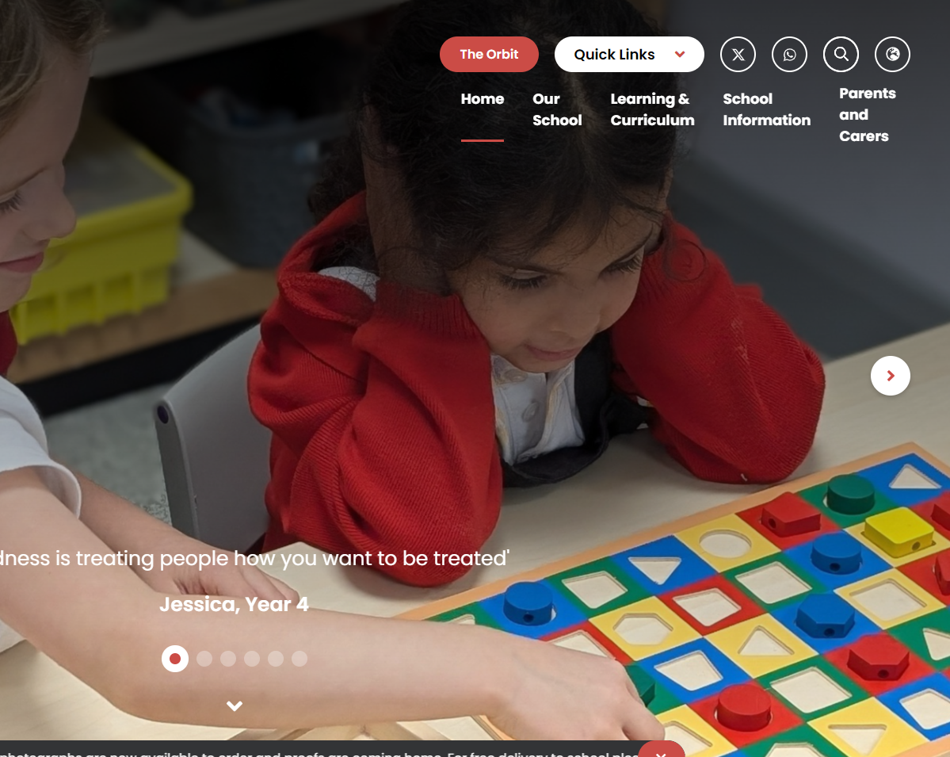
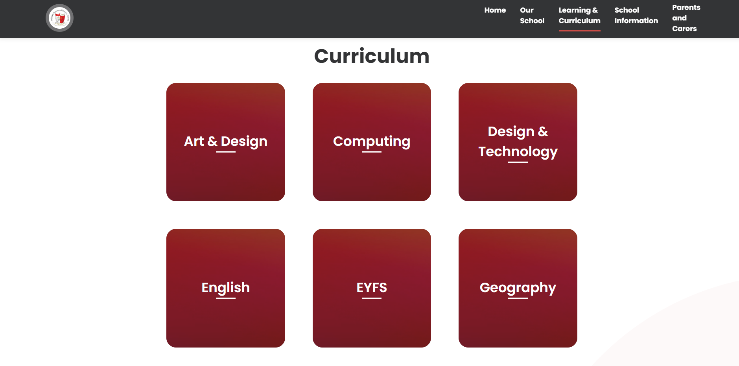
Where to find useful information: our website
Intent, Implementation & Impact Document
Intent – our aims for our English teaching
Implementation – how we teach English
Impact – measure progress and effectiveness of everything we do in English

Slide 4
Bug Club Phonics Overview
Reception
Phases 2, 3 and 4
Year 1
Phase 3 revision
Phase 5 to be completed by May half term
Phase 6 may be taught after the Screening Check depending on the cohort
Year 2
Phase 5 revision/alternatives
Phase 6

Slide 5
Phonics in Year 1
13 – wh ph
14 – ay a-e eigh/ey/ei
15 – ea e-e ie/ey/y
16 – ie i-e y
17 – ow o-e o/oe
18 – ew ue u-e u/oul
19 – aw au al
20 – ir er ear
21 – ou oy
22 – ere/eer are/ear
23 – c k ck ch

Slide 6
Phonics in Year 2
Phase 5 alternatives
24 – c(e) c(i) c(y) sc st se
25 – g(e) g(i) g(y) dge
26 – le mb kn gn wr
27 – tch ea s wa o
Suffixes
-ing
-ed
-s
-es
Prefixes
re-
un-

Slide 7
Phonics Terminology
Phoneme - the smallest unit of sound as it is spoken
Grapheme - a written symbol that represents a sound (phoneme) that's either one letter or a sequence of letters
Digraph - two letters that work together to make the same sound (ch, sh, ph)
Vowel digraph - a digraph in which at least one of the letters is a vowel: boat or day
Consonant digraph - two consonants which can go together: shop or thin.

Slide 8
Phonics Terminology
Split digraph (sometimes called 'magic e') - two letters that work together to make the same sound, separated by another letter in the same word. This enables children to understand the difference in vowel sounds between, for example, grip/gripe, cop/cope, tap/tape
Trigraph - three letters that work together to make the same sound (igh, ore, ear)
Pure sound - it's the skill of pronouncing each letter sound clearly and distinctly without adding additional sounds to the end e.g. 'f' not 'fuh.‘

Slide 9
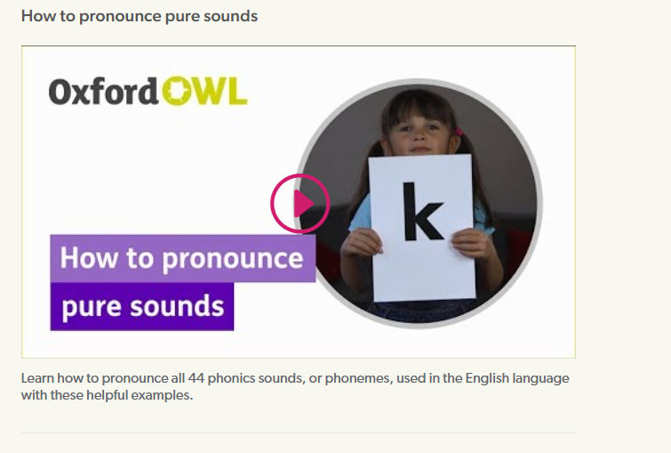
Phonics videos – help your child learn to read - Oxford Owl
Google Oxford Owl Phonemes – how to pronounce pure sounds​

Slide 10
Phonics Terminology
Blend - this is when you say the individual sounds that make up a word and then merge or blend them together to say the word as used when reading
Segment - it's the opposite of blending as it means splitting a word up into individual sounds when spelling and writing.

Slide 11
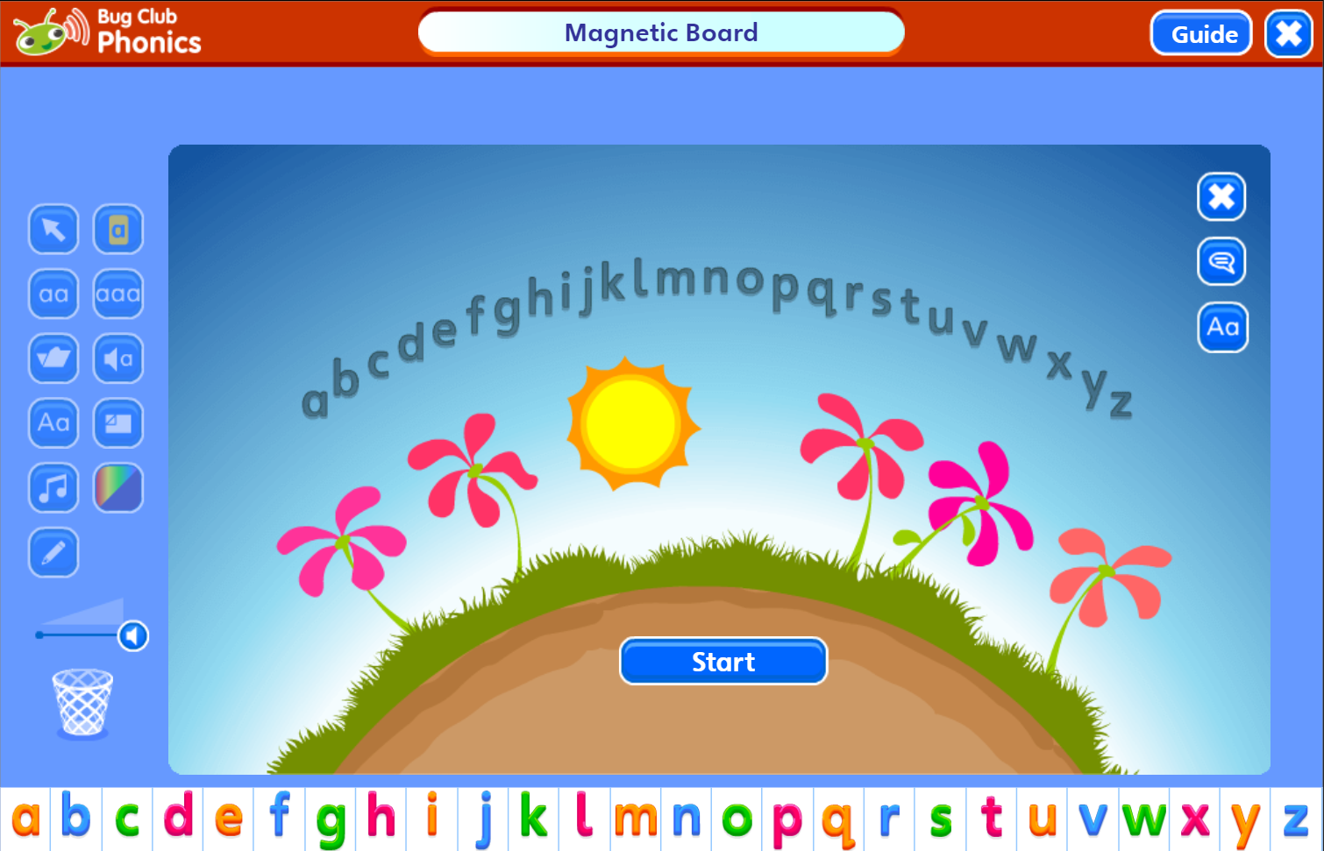
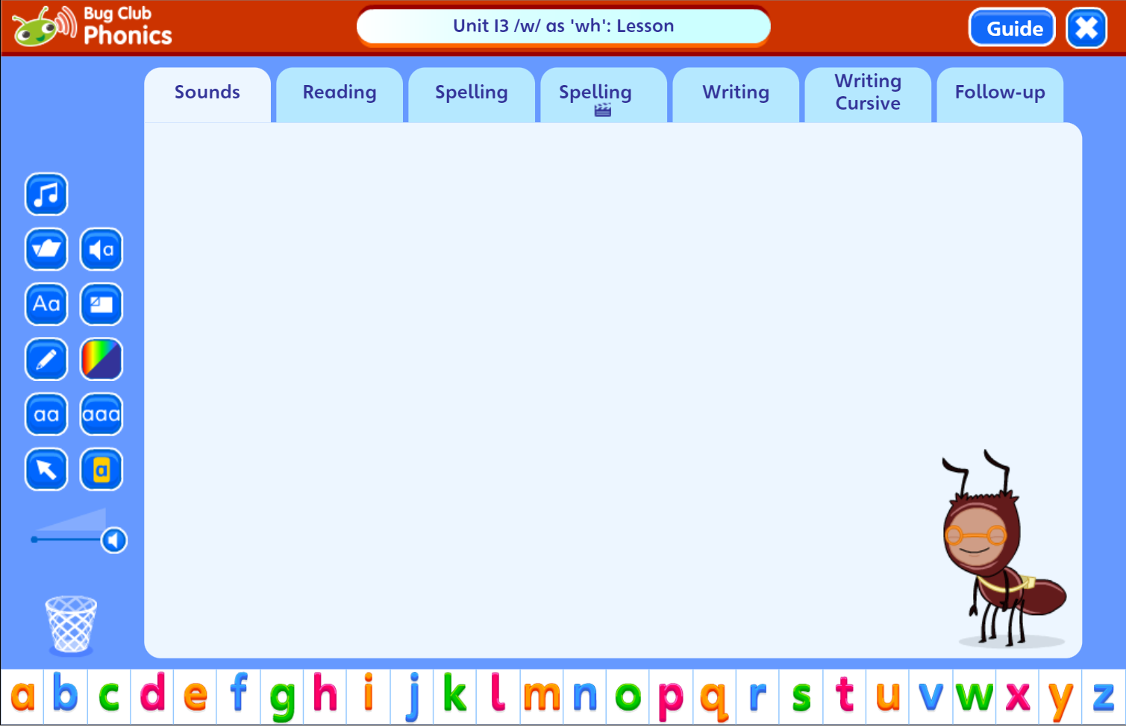
What does a Bug Club lesson look like?

Slide 12
What can you do at home?
Help your child to complete any Phonics homework they bring home
Year 1 spellings are linked to the phonemes covered in class each week
Year 2 spellings are taken from Spelling Shed
Encourage your child to use their phonics when they are reading at home
Useful websites: phonicsplay.co.uk
topmarks.co.uk
phonicsbloom.com
Listen to your child read every night – sign and date the Reading Records. Make sure their reading books are in school every day.
Bug Club reading books set weekly for Years 1 and 2

Slide 13
Reading Fluently
Re-reading books is important for developing fluency. When children reread a book, they don’t have to focus so much on decoding and understanding the words – they are free to concentrate on reading with pace, accuracy and expression
"Fluent reading supports reading comprehension. When pupils read fluently, their cognitive resources can be redirected from focusing on decoding and onto comprehending the text. For this reason, fluency is sometimes described as a bridge from word recognition to comprehension." EFF
"As pupils gain fluency, their motivation increases: they start to enjoy reading more and are willing to do more of it." Reading Framework

Slide 14
Fluency Practice
Opportunities for acting out e.g particular character dialogues or actions (children will need to see models of this from adults)
Reading aloud is an opportunity to demonstrate fluency while also helping listeners to make meaning.
Echo reading – a re-reading strategy to help children develop fluent, expressive reading.
Choral reading – reading aloud in unison with a class or group of children. Helps to build fluency, self-confidence and motivation.
Repeated reading – engaging children in repeatedly reading texts improves reading ability. This involves pupils re-reading a short text a set number of times or until they reach a suitable level of fluency.

Slide 15
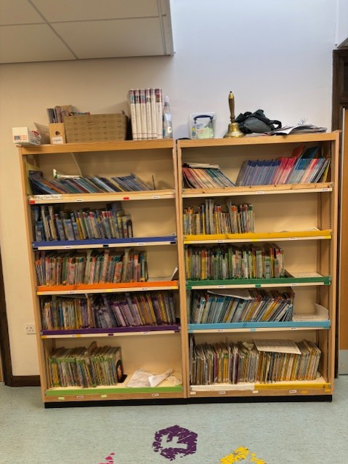
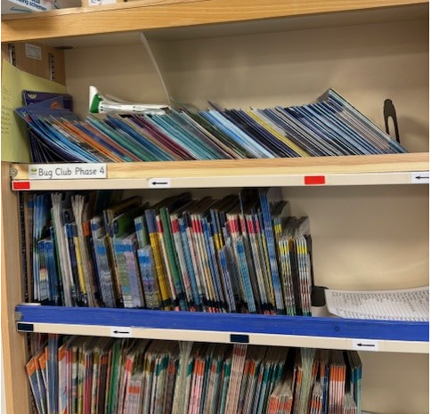
The Key Stage One Reading Scheme
From January 2025…
All KS1 reading books will be changed once a week.
2/3 books will come home each Monday
Children still expected to read every night – re-read books to develop fluency
Teachers will move children on when assessed

