Slide 1
THE LET GROW EXPERIENCE
Because independence is
childhood’s rocket fuel.
Notes:
(Intro, all audiences) If desired, this is a good spot for presenter to share a moment of personal storytelling. Presenter could recount a powerful memory of childhood independence - what they did, how it felt, and how it changed how they perceived themselves and their capabilities, resilience, and sense of agency.

Slide 2
When adults step back…
Kids step UP!
Notes:
(Intro, all audiences)

Slide 3
It’s a simple life-changing homework assignment:
“Go home and do something new on your own.”
Notes:
(Intro, all audiences) Let Grow Experience involves kids in simple, independent experiences that yield powerful effects. No fussy, cumbersome projects. Instead, Let Grow projects are straightforward, everyday independent moments and experiences that all kids need to experience.

Slide 4
Climb a tree,
Run an errand,
Make a meal…
Notes:
(Intro, all audiences) Let Grow Experience involves kids in simple, independent experiences that yield powerful effects. No fussy, cumbersome projects. Instead, Let Grow projects are straightforward, everyday independent moments and experiences that all kids need to experience.

Slide 5
The choices are endless and the impact: immediate.
Notes:
(Intro, all audiences)

Slide 6
Simply by experiencing some independence…
kids find themselves:
engaged
excited
and curious
Notes:
(Intro, all audiences)

Slide 7
They analyze situations,
evaluate consequences,
and discover how resourceful they really are.
Notes:
(Intro, all audiences)

Slide 8
Everyone sees the change:
educators
parents
the kids themselves
Notes:
(Intro, all audiences)

Slide 9
Independence leads to
new problem-solving,
resilience—and joy.
Notes:
(Intro, all audiences)

Slide 10
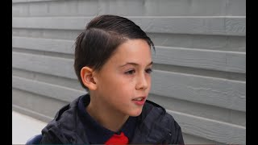
Notes:
(Intro, all audiences) Overview Video (3:03): Brief overview of the Let Grow Experience, especially the types of independent activities students might choose to do. (The Let Grow Experience at Ortwein Elementary, Nevada; 3:28)

Slide 11
Take a moment, and think back to a childhood memory you treasure the most . . .
an independent experience when your parents let you do your own thing,
maybe something that many people maybe don’t allow their own child to do independently today.
Notes:
(Intro, all audiences) ACTIVITY: Ask audience to think back, remember a moment or experience of independence* from their childhood.
*without direct adult supervision
- Could be something you did on your own, or with a friend or group of friends
- Maybe it was even a time something went wrong and you had to figure out what to do – and you did.
"When you think back to your childhood, what memories do you treasure most? Climbing to the top of the tallest trees? Riding bikes around the neighborhood with friends? Building a secret fort deep in the woods? Chances are good you had the most fun (and probably learned the most, too) when your parents let you do your own thing. The Let Grow Experience aims to restore childhood resilience by pushing back on overprotection.
This experience helps us gradually give kids the kind of freedom and responsibility (and fun) you probably remember from your own childhood."

Slide 12
What was so powerful or memorable about that experience or activity?
How do you think it shaped you or
helped you grow?
Notes:
(Intro, all audiences) Activity (continued): Why do you think that memory stuck with you? What effect did it have on you?

Slide 13
“IT WAS LIKE SEEING KIDS
COME BACK TO LIFE”
—Johann Hari, author of
the bestseller Stolen Focus
Notes:
(Testimonial) Bestselling author Johann Hari's book Stolen Focus investigates why our ability to focus and pay attention is collapsing. As part of his research, he had the opportunity to visit a Let Grow school, and observed the powerful, positive impact Let Grow was having on the students. These seemingly small moments of independence can be transformative for kids. As the saying goes, “Big doors open on small hinges.”

Slide 14
Kids become more self-confident, doing more things on their own, including homework!
Parents recognize their children are more capable than they realized.
Educators report increases in student maturity and improved school climate.
Most kids report that doing the Project reduced anxiety levels, increased their self-confidence, and improved their relationships with their parents.
Notes:
(Intro, all audiences) Here is what the research is telling us so far about the Let Grow Experience impact on kids, parents, and schools.

Slide 15
LETTING GO IS AN ACT OF BRAVERY.
Your kids will thank you for it.
Notes:
Stepping back back can feel difficult at first, but as parents notice the ways Let Grow is helping their kids become more independent, it helps them feel more comfortable and confident to step back a bit to let that happen.

Slide 16
I USED TO THINK…
“...that my job as parent was to keep her safe always and the only way to do that was to hover constantly around her.”
Notes:
(Testimonial: Use alone, or can be paired with video slide “A Psychologist Discusses “Over-helping’ Our Kids” ) Parents are noticing the ways Let Grow is helping their kids become more independent (and helping them as parents to feel more comfortable and confident to step back a bit to let that happen).

Slide 17
NOW I THINK…
“...just like I think it’s important to give her nutritious food, and to give her wealth of opportunities, that I need to give her the opportunity to be independent.”
Notes:
(Testimonial: Use alone, or can be paired with video slide “A Psychologist Discusses “Over-helping’ Our Kids” ) Parents are noticing the ways Let Grow is helping their kids become more independent (and helping them as parents to feel more comfortable and confident to step back a bit to let that happen).

Slide 18
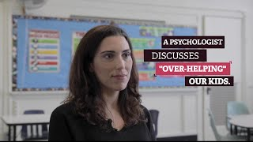
Notes:
(Testimonial) VIDEO (2:25): “A Psychologist Discusses Over-helping Our Kids” This mom (who is also a psychologist) shares how Let Grow is helping kids become more independent (and helping parents to feel more comfortable and confident to step back a bit to let that happen).

Slide 19
“Talking to my friends about it… it’s given us a heightened sense of awareness, of, ‘Wait a second. Yes. We can let them go out and play… They can play by themselves.’”
Notes:
(Testimonial: Use alone, or can be paired with video slide “A Nervous Mom Learns to Let Go (And Let Grow)” ) Let Grow helps parents become part of a community that is creating a culture of independence for kids. It helps build that "strength in numbers" that gives parents greater confidence to step back and allow kids the independence they *need* to experience.

Slide 20
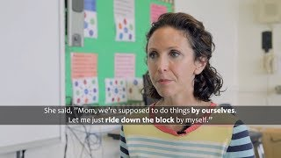
Notes:
(Testimonial) VIDEO (1:38): “A Nervous Mom Learns to Let Go (And Let Grow)” One mom shares how Let Grow has helped her feel like she is a part of a community of parents that is creating a culture of independence for kids. The experiences has helped build that "strength in numbers" that gives parents greater confidence to step back and allow kids the independence they *need* to experience.

Slide 21
“It teaches you a lot of what you CAN do.”
“It teaches you to go out and explore more.”
“You learn to be adventurous instead of playing video games all day.”
“I learned you can do what your mind sets to do.”
“It is fun to feel like I am big enough to do things by myself. I can’t wait for my next adventure.”
Notes:
(Testimonial) What kids are saying about the Let Grow Experience

Slide 22
LET GROW HELPS STUDENTS WITH ANXIETY
“I can talk to people one-on-one now and don’t have to worry about. ‘Oh, gosh, what am I going to say next?’ …
Notes:
(Testimonial: Use alone, or can be paired with video slide “ “Learn How the Let Grow Project Can Help Kids with Anxiety”)

Slide 23
LET GROW HELPS STUDENTS WITH ANXIETY
…Now, when I have to get out of my comfort zone I’m find with it because I’ve done so many things out of my comfort zone.”
Notes:
(Testimonial: Use alone, or can be paired with video slide “ “Learn How the Let Grow Project Can Help Kids with Anxiety”)

Slide 24
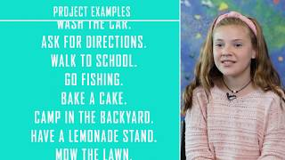
Notes:
VIDEO (2:22): “Learn How the Let Grow Project Can Help Kids with Anxiety” (Note: These middle school students are growing up in a privileged neighborhood, so their experiences might not directly relate to your student population. It's okay to skip this slide or acknowledge here that “this is not necessarily representative of our student population, our students' experiences.")

Slide 25
“Now, I practice doing things on my own and figuring things out on my own.”
Walked to the end of my block for the first time, now I do it all the time.
I learned to do new things like doing coffee for my grandpa.
Packed my own lunch.
Notes:
(Testimonial; students) Here are just a few Let Grow examples from an elementary school. These kids took so much pride in doing things on their own for the first time!
As you'll see, independence experiences can vary from one kid to the next. No matter their starting point, choosing a project just outside of their comfort zone will result in growth.

Slide 26
Helps unleash students’ natural curiosity and confidence.
Interested and engaged kids are better learners inside and outside the classroom.
Notes:
(Intro, all audiences) Let Grow impacts kids outside AND inside the classroom! Independence is a key ingredient to thriving classrooms. Let Grow helps create capable, confident, and resilient students, without placing an instructional burden on teachers.
The Let Grow Experience is primarily an out-of-school intervention.

Slide 27
The Let Grow Experience meets each child, each family exactly where they are,
and nurtures growth from that point forward.
Notes:
(Intro, all audiences) No two kids have the same starting point. And that's perfectly okay! The key is for each kid, each family to start where they are. -Project options and choices are completely individual
-"right fit" is different for each child/student
-No measuring of students to a common standard

Slide 28
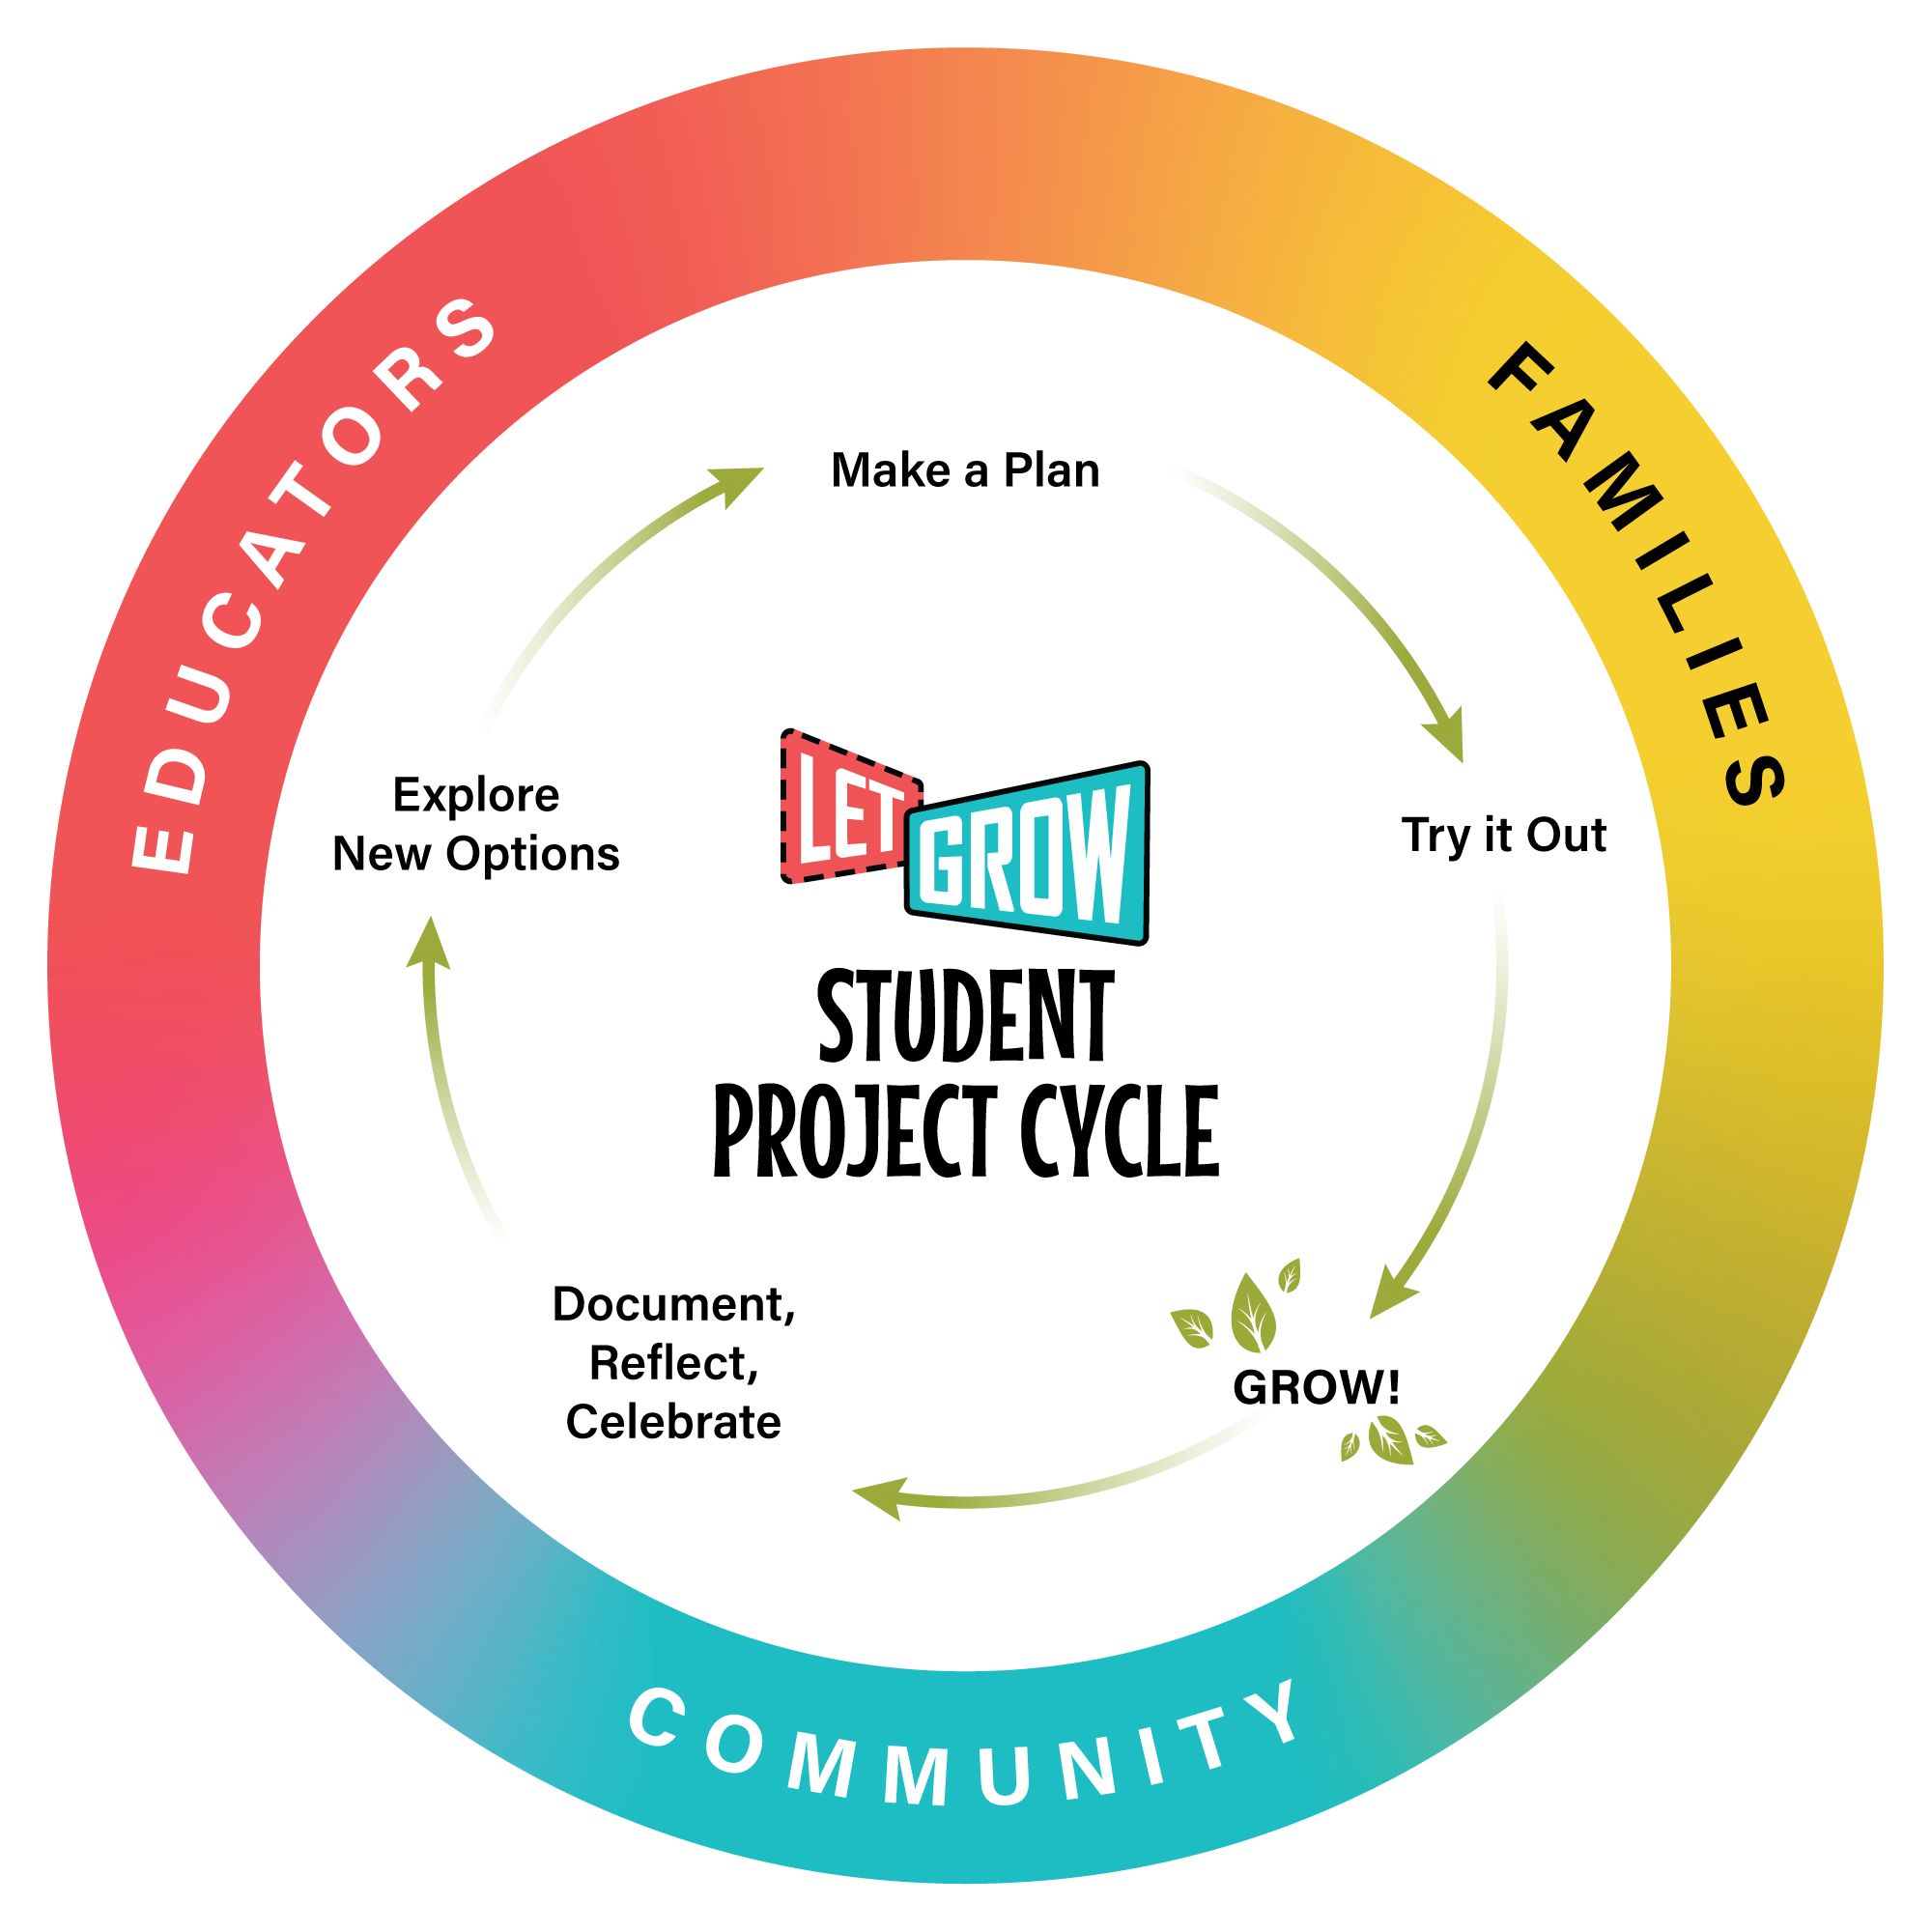
Notes:
(Intro, all audiences) Each month, students will go through the Let Grow Experience "project cycle". They repeat this each month, choosing new experiences and projects each month.
While the project itself is at the heart of it all, students (and parents!) also take time to reflect on their experience, and celebrate their growing independence. This helps create a self-reinforcing loop of continuous growth.
When it comes to giving kids independence experiences they need, no one needs to "go it alone".
The Let Grow Experience is designed to help families, educators, and the wider community work together to make it all happen.
While the project itself is at the heart of it all, students (and parents!) also take time to reflect on their experience, and celebrate their growing independence. This helps create a self-reinforcing loop of continuous growth.
When it comes to giving kids the independence experiences they need, no one needs to "go it alone".
The Let Grow Experience is designed to help families, educators, and the wider community work together to make it all happen.

Slide 29



Each month . . .
Let your child take the lead.
Step back, so your child can step up.
You and your child reflect on the experience.
Project Ideas List for inspiration
Letting go is an act of bravery!
Project Handout includes conversation starters
Your Role
3.
How did
it go?
1.
Pick a Project.
2.
Project time!
Notes:
(For parent audience)
Each month, your school will share with you a one-page Project Handout.
(Presenter: Note here how the parents/family will receive this. Email? Link in newsletter? Or a printout that comes home with the student?)
Your role is mostly hands-off (no need to go buy posterboard, or last-minute trips for a special costume!).
Just be present for your child as they choose a project. Take time to talk with your child after they have done their project, to allow both of you to reflect on the experience and think about what they (and you!) might be ready for next.

Slide 30
Encouraging Independence at Home
Wait before helping.
Let your child lead.
Let them explore, play, and discover new hobbies.
Notes:
(For parents)
Nurturing your child's sense of independence can happen almost anytime, and anywhere.

Slide 31
What I was allowed to do on my own as a kid:
What I allow my kid to do on their own now:
What I don't allow my kid to do
on their own yet:
Notes:
(For parent audience - Optional parent activity:)
Provide parents with handout (or blank paper) to list the following:
-things they were allowed to do on their own as a kid
-what they allow their own child to do on their own now
-what they don't allow child to do on their own *yet*
Encourage parents to seal it in an envelope (school could provide). Parents will review later in year to compare how the Let Grow Experience may have changed how they think about their child's capability to be independent.
When revisiting list later in the year, try this framework:
("I used to think _________, but now I think __________.")

Slide 32
NEXT UP:
Stay tuned for your first monthly Project Handout
that will guide you and your child through
their first Let Grow Project!
Notes:
(Parent audience) Presenter: Here, share with parents/families general information about next steps. State when and how (print? digital?) the first monthly handout will be sent home, and also that materials will be sent home each subsequent month. Mention that project ideas will be included with each monthly handout (students can choose from ideas list or come up with their own project idea).

Slide 33
Q & A

