Slide 1

KS1
Information for Parents
How you can support your child in English

Slide 2
English:
Reading
Phonics
Writing
Speaking and Listening

Slide 3
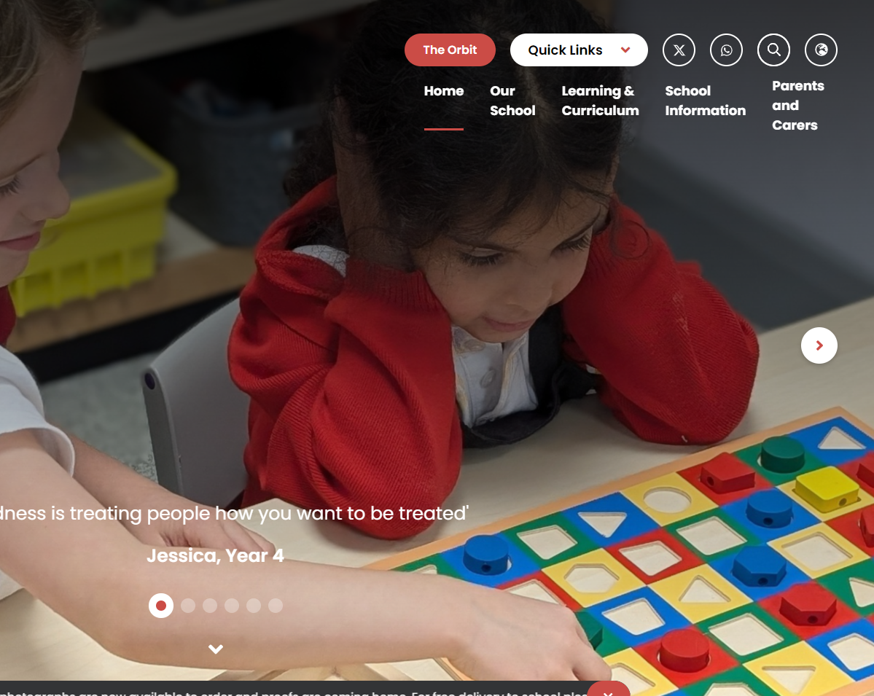
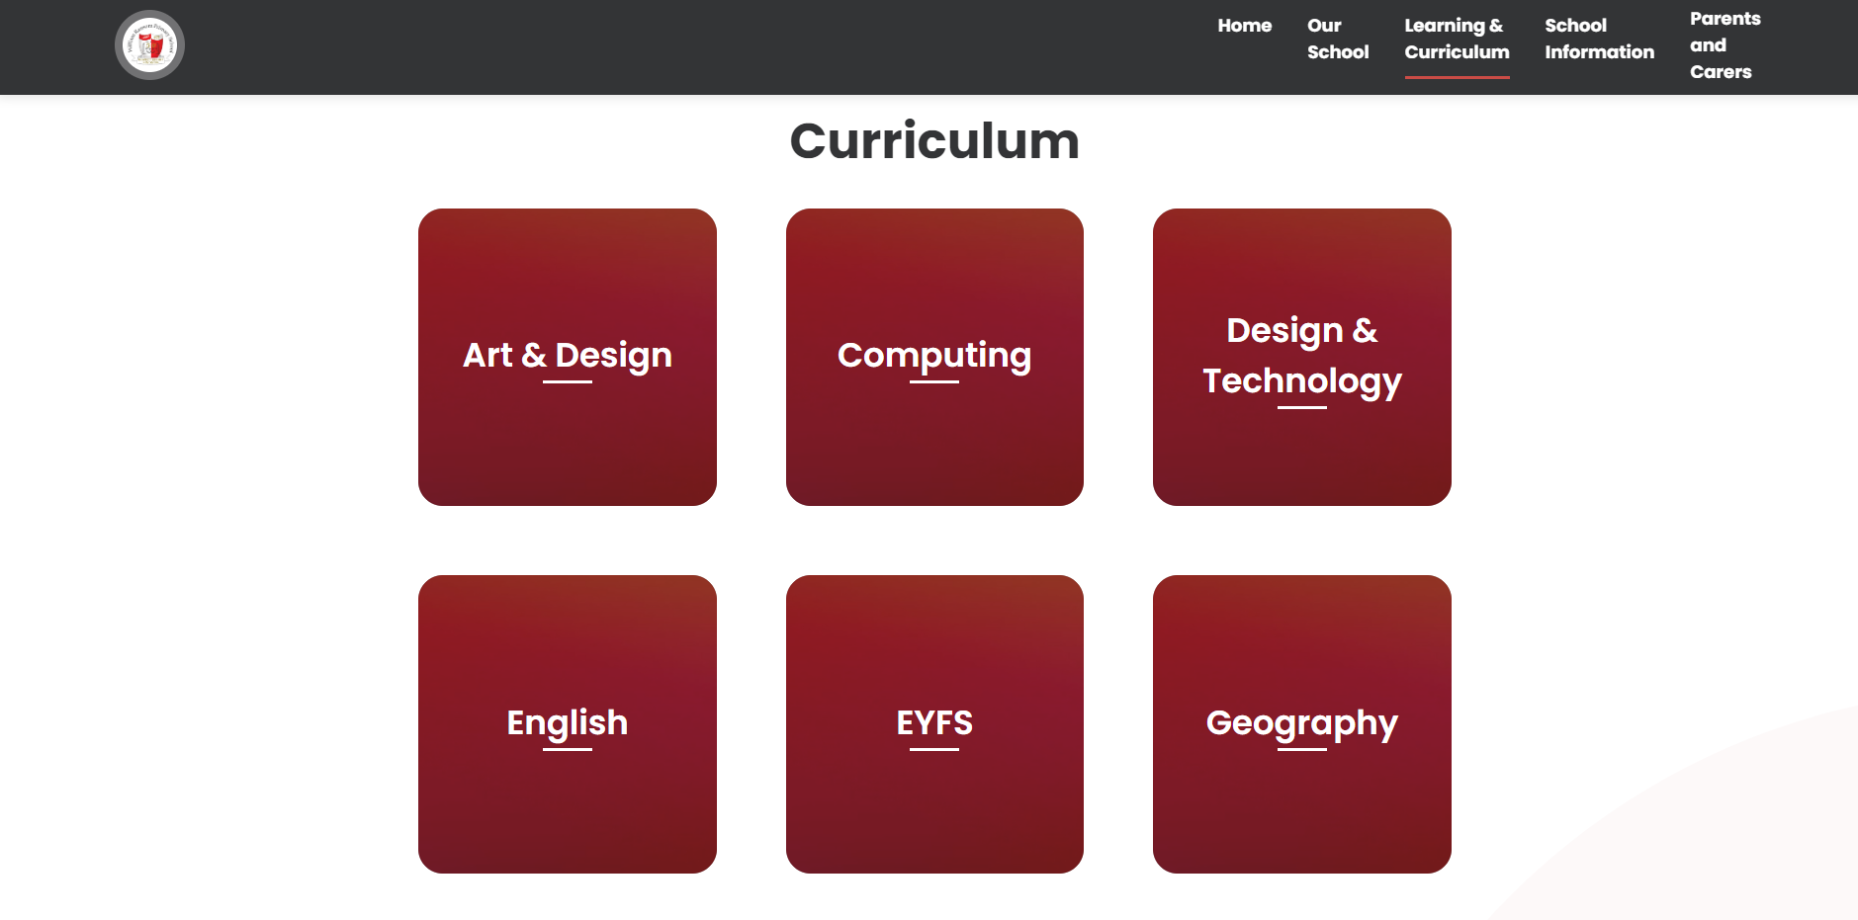
Where to find useful information: our website
Intent, Implementation & Impact Document
Intent – our aims for our English teaching
Implementation – how we teach English
Impact – measure progress and effectiveness of everything we do in English

Slide 4
Bug Club Phonics Overview
Reception
Phases 2, 3 and 4
Year 1
Phase 3 revision
Phase 5 to be completed by May half term
Phase 6 may be taught after the Screening Check depending on the cohort
Year 2
Phase 5 revision/alternatives
Phase 6

Slide 5
Phonics in Year 1
13 – wh ph
14 – ay a-e eigh/ey/ei
15 – ea e-e ie/ey/y
16 – ie i-e y
17 – ow o-e o/oe
18 – ew ue u-e u/oul
19 – aw au al
20 – ir er ear
21 – ou oy
22 – ere/eer are/ear
23 – c k ck ch

Slide 6
Phonics in Year 2
Phase 5 alternatives
24 – c(e) c(i) c(y) sc st se
25 – g(e) g(i) g(y) dge
26 – le mb kn gn wr
27 – tch ea s wa o
Suffixes
-ing
-ed
-s
-es
Prefixes
re-
un-

Slide 7
Phonics Terminology
Phoneme - the smallest unit of sound as it is spoken
Grapheme - a written symbol that represents a sound (phoneme) that's either one letter or a sequence of letters
Digraph - two letters that work together to make the same sound (ch, sh, ph)
Vowel digraph - a digraph in which at least one of the letters is a vowel: boat or day
Consonant digraph - two consonants which can go together: shop or thin.

Slide 8
Phonics Terminology
Split digraph (sometimes called 'magic e') - two letters that work together to make the same sound, separated by another letter in the same word. This enables children to understand the difference in vowel sounds between, for example, grip/gripe, cop/cope, tap/tape
Trigraph - three letters that work together to make the same sound (igh, ore, ear)
Pure sound - it's the skill of pronouncing each letter sound clearly and distinctly without adding additional sounds to the end e.g. 'f' not 'fuh.‘

Slide 9
Phonics Terminology
Blend - this is when you say the individual sounds that make up a word and then merge or blend them together to say the word as used when reading​
​
Segment - it's the opposite of blending as it means splitting a word up into individual sounds when spelling and writing.​

Slide 10
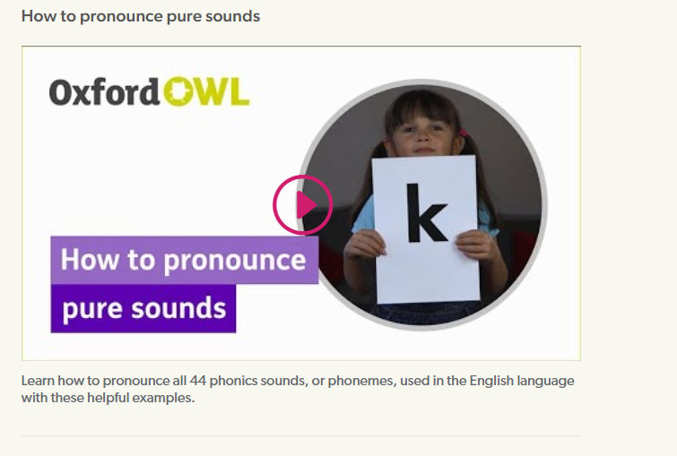
Phonics videos – help your child learn to read - Oxford Owl
Google Oxford Owl Phonemes – how to pronounce pure sounds​

Slide 11
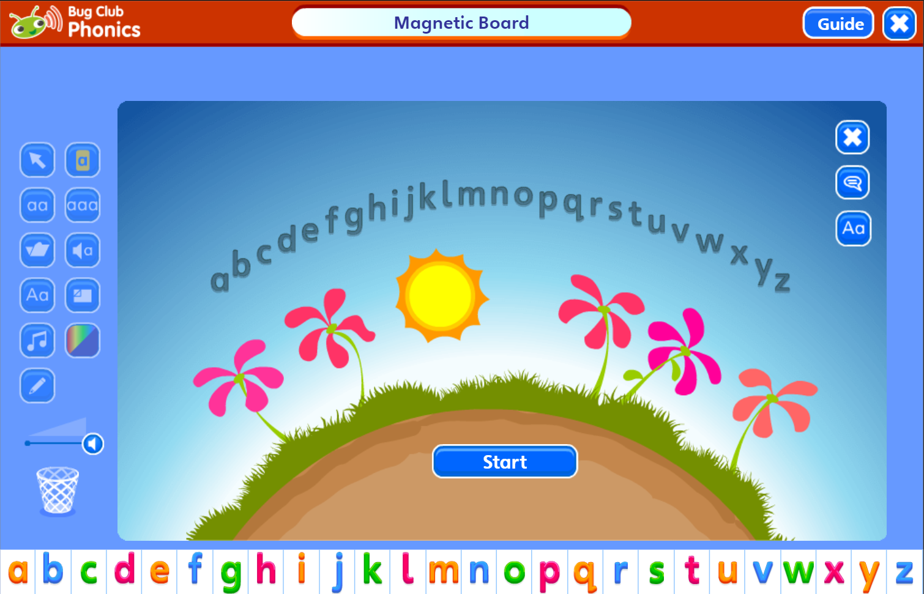
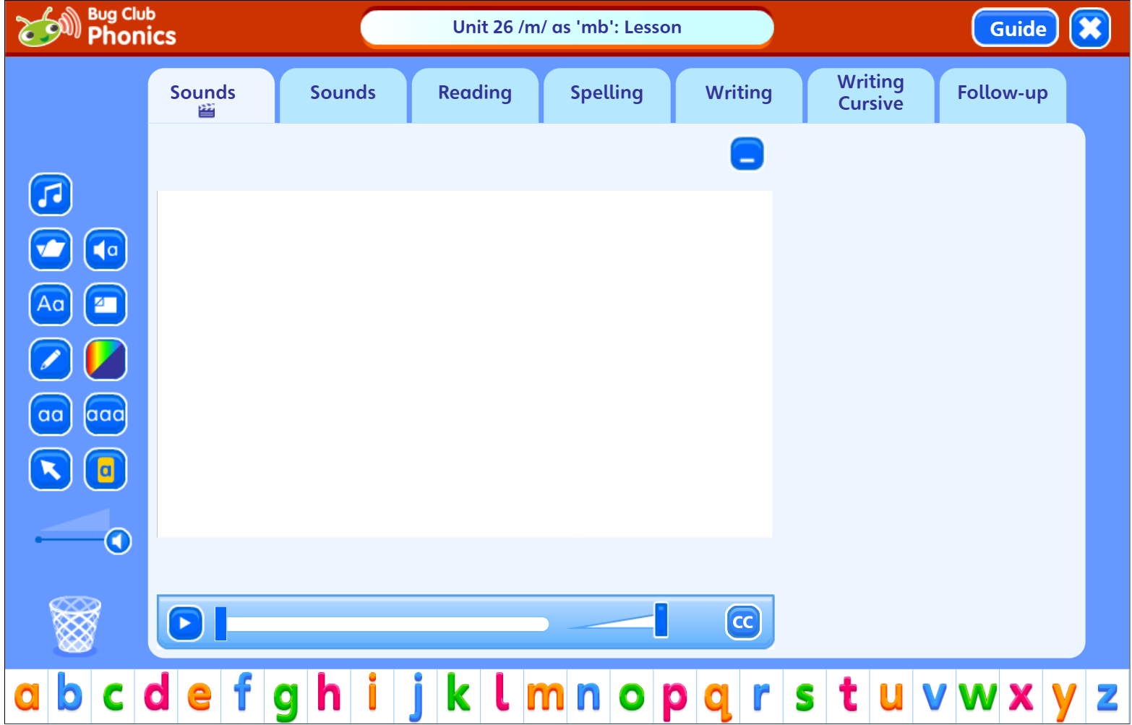
What does a Bug Club lesson look like?

Slide 12
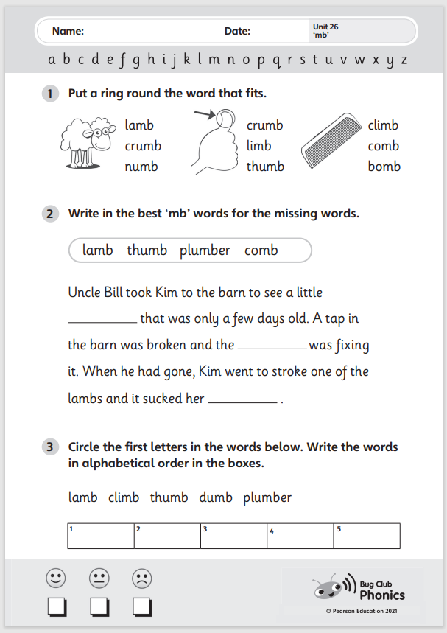
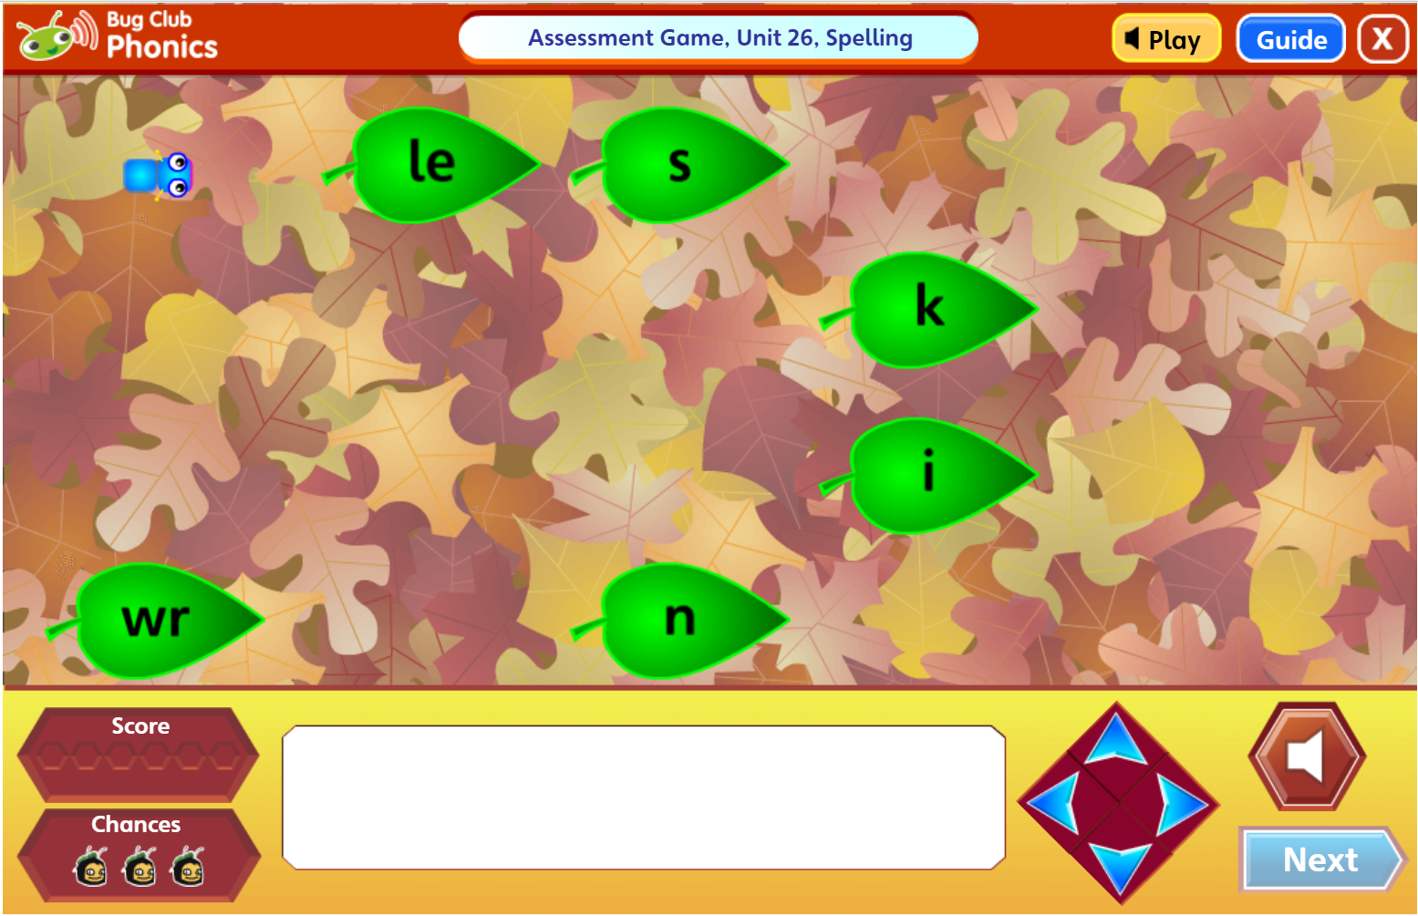
What does a Bug Club lesson look like?

Slide 13
What can you do at home?
Help your child to complete any Phonics homework they bring home
Year 2 spellings are taken from Spelling Shed – starts in the Spring term
Encourage your child to use their phonics when they are reading at home
Useful websites: phonicsplay.co.uk
topmarks.co.uk
phonicsbloom.com

Slide 14

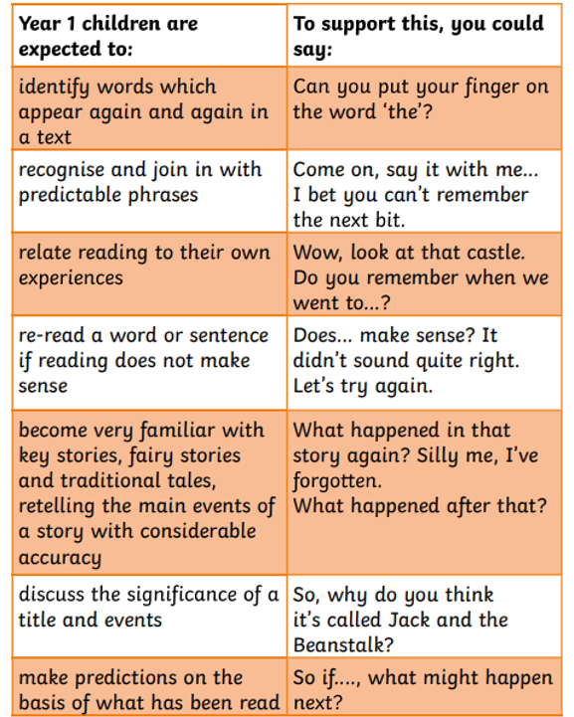
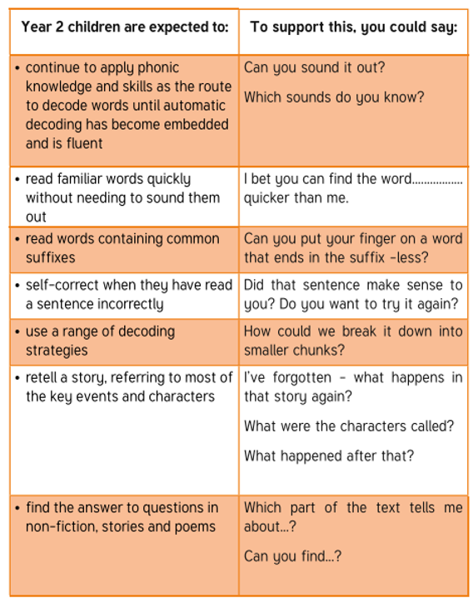

Most importantly…
Listen to your child read every night – sign and date the Reading Records.
Make sure their reading books are in school every day.
Use the reading prompts in the front of the Reading Record.
Look out for ‘Words I might not know…’

Slide 15
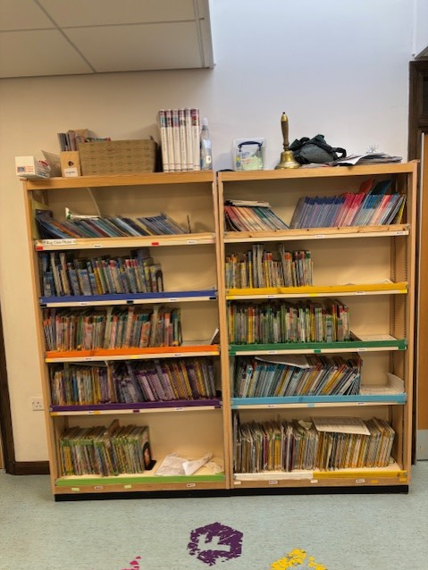
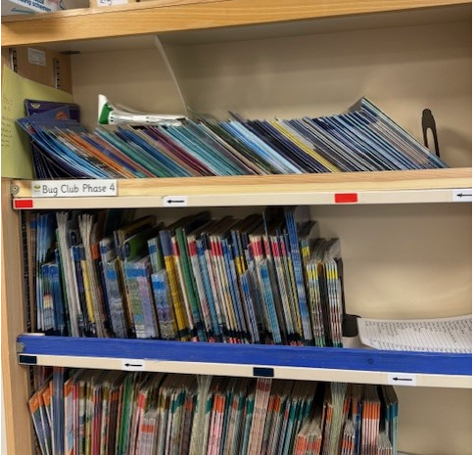
The Key Stage One Reading Scheme
All KS1 reading books will be changed once a week.
2/3 books will come home each Friday
Children still expected to read every night – re-read books to develop fluency
Teachers will move children on when assessed
Books must still be sent into school every day

Slide 16
Fluency Practice
Opportunities for acting out e.g particular character dialogues or actions (children will need to see models of this from adults)
Reading aloud is an opportunity to demonstrate fluency while also helping listeners to make meaning.
Echo reading – a re-reading strategy to help children develop fluent, expressive reading.
Choral reading – reading aloud in unison with a class or group of children. Helps to build fluency, self-confidence and motivation.
Repeated reading – engaging children in repeatedly reading texts improves reading ability. This involves pupils re-reading a short text a set number of times or until they reach a suitable level of fluency.

